Slide 1


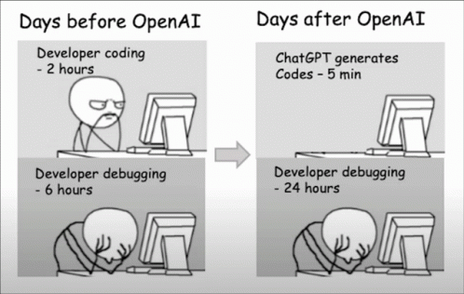

Integrating Synthetic Data in NLP Instruction Tuning Model to Improve Performance in Handling Diverse Tasks and Study its Impact
Presentation by Randal Chan
Collaborated with
Liang Shihao, Du Yutong
Yan Chenjia and LI Jiajun
27 November 2023
Notes:
Slide 1
Good evening everyone. I am Randal Chan and I am joined by my fellow groupmates.
As computer science students, we share the same headache.
(Click) We have ChatGPT now but sometimes it fails badly especially for unseen tasks.
Our team’s motivation is thus to integrate synthetic data into the NLP instruction tuning model, study its impact and to alleviate this common headache.

Slide 2






Outline
Gist of the Reference Paper
Research Objectives and Hypothesis
Methodology and Implementation
Analysis Result and Open Discussion
Notes:
Slide 2
Here is the outline of presentation.
We will start by discussing the reference paper.
Then, we will highlight our objective and hypothesis; followed by the methodology and implementation.
Finally, we will present the result and engage a brief discussion.

Slide 3
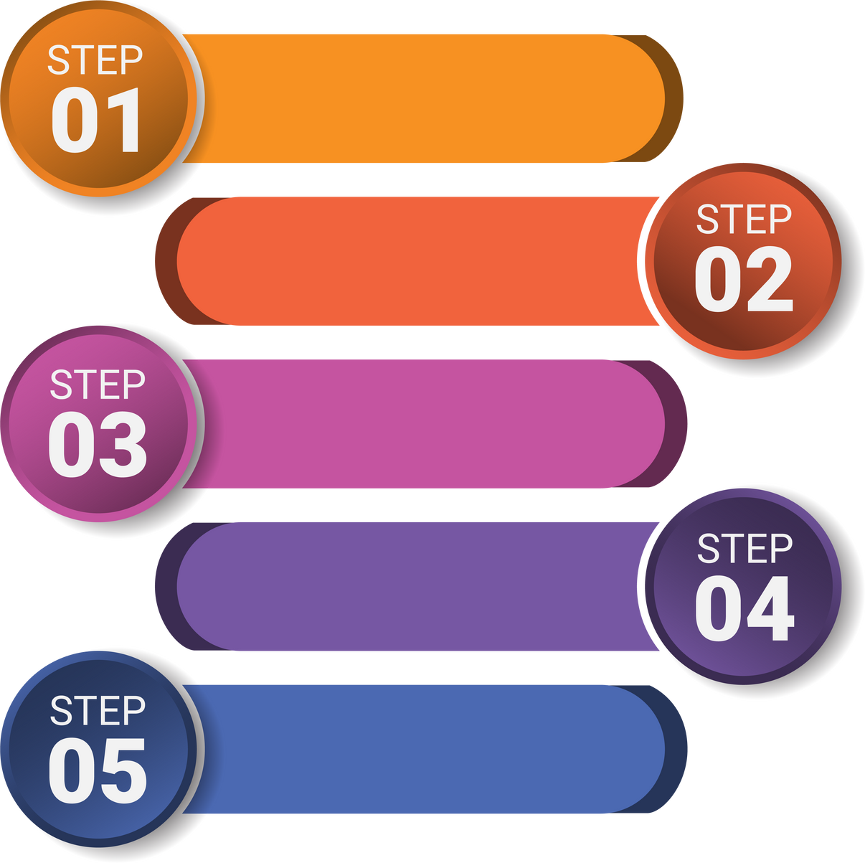
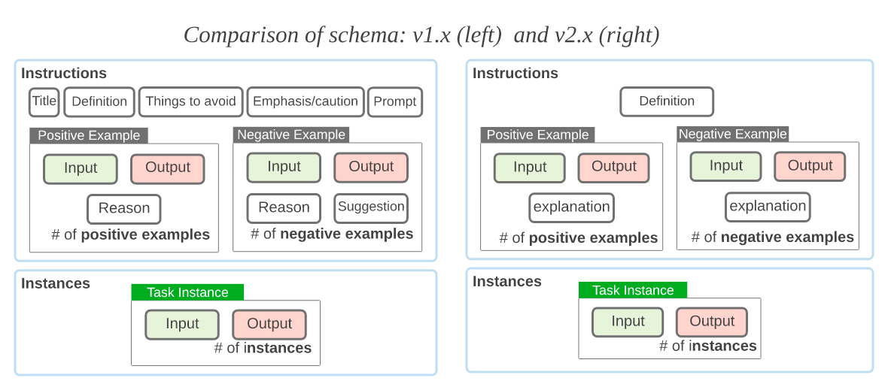
Methodology
Reference Paper
Based on T5 Model
Title:
Leverage the
SUPER Dataset
SUPER-NATURALINSTRUCTIONS: Generalization via Declarative Instructions on 1600+ NLP Tasks (2022) (hereafter SUPER)
In-context Instructions on
SUPER Dataset
Key highlights:
Created Benchmark “Super-Nat” based a meta-dataset (herafter SUPER Dataset) with 1,616 NLP tasks - for evaluating the generalization capabilities based on EM & ROGUE-L;
Developed “Tk-instruct” Model, trained with Super Dataset by adding “in-context instructions” (for instance adding “definition”).
Result: Outperforms Pretrained LMs in handling unseen tasks.
Fine-tuning T5 Model with
new dataset
Evaluate with
SUPER-NAT benchmark
In-context Instructions
Notes:
Slide 3
Our reference paper “supernatural instruction” was released a year ago.
It introduced the "Super-Nat" benchmark which contains more than 1,600 NLP tasks for evaluating model on handling diverse tasks.
Secondly, the paper developed Tk-instruct model.
Tk-Instruct was developed on T5 model, and they introduced in-context instruction to their dataset for fine-tuning. The model outperformed the pretrained LMs like GPT on Super-Nat benchmark.

Slide 4


Research Objective and Hypothesis
Objective
Reproduce Tk-Instruct & create a variant model to outperform it? But HOW? (i.e., pure human labor work with 88 people + One year to build their dataset)
Develop a cost-effective variant model of Tk-Instruct by integrating synthetic dataset, achieving comparable generalization capability on the SUPER benchmark, and to analyze its impact compared to model trained on human-annotation data (i.e., Tk-Instruct).
Hypothesis
The integration of synthetic data is hypothesized to yield comparable effectiveness and may bring “new element” to the original model.
Notes:
Slide 4
Tk-Instruct model looks perfect to be our baseline.
If we can develop a variant model with comparable performance, it would be impressive.
But Think about this: Tk-instruct was built with a team of top-scholars who had spent a year collecting a dataset from 88 people before fine-tuning.
[Click, photo] and apparently we have some cost and time constraint to compete with human resource.
So, we decided to go with machine. Our objective is to integrate the synthetic data into SUPER dataset, study its impact comparing to the model trained with human annotated data.
We hypothesised that synthetic data may bring “new element” to the original model

Slide 5

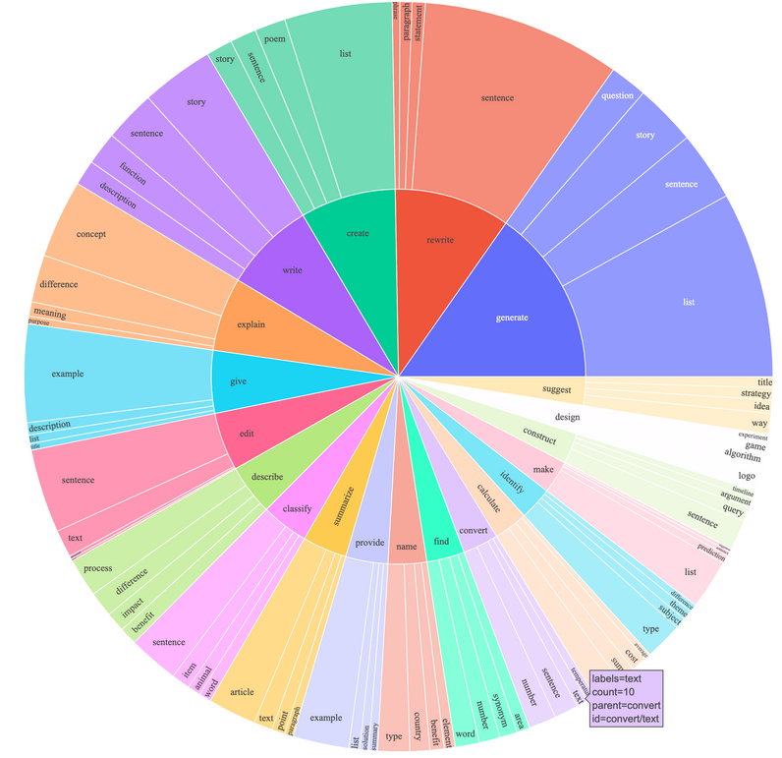
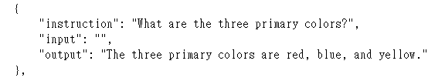
Methodology - Data Ablation
DATASET
Consists of 52K instruction-following demonstrations generated in the style of self-instruct using text-davinci-003.
Showcasing similar behaviors to OpenAI's text-davinci-003 while being remarkably compact and cost-effective to reproduce (“costed less than $500 using the OpenAI API”).
Demonstration of Alpaca Data
Diversity Tasks in Alpaca
Notes:
Slide 5
For a synthetic dataset that is open to the public, with diverse tasks and instruction tuning concept, we identified a dataset created by Stanford called Alpaca.
It consists of 52K instructions following demonstrations and more importantly it is cheap.
The bottom left is an example of Alpaca Data

Slide 6

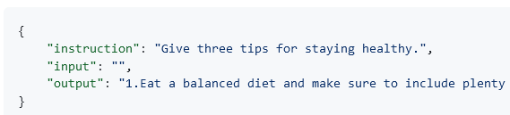


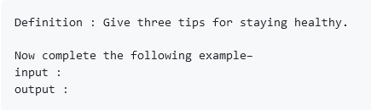
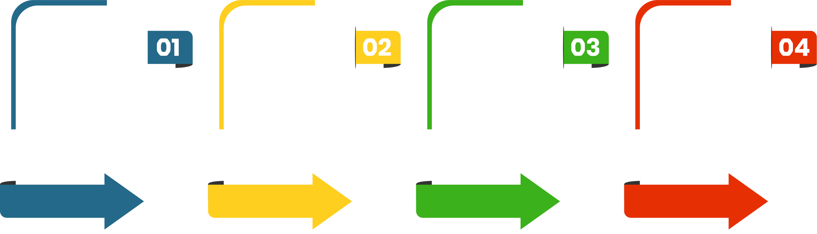
Alpaca Raw
Alpaca Heuristic
↓Model↓
↓PREPROCESS↓
↓FINE-TUNING↓
↓EVALUATION↓
Raw Alpaca
Alpaca in Tk-instruct format
Fine-tune by integrating SUPER with one of the two processed dataset
T5-LM 3B Model
(Same as Tk-Instruct)
Evaluate based on SUPER Nat
benchmark and conduct analysis
Notes:
Slide 6
For implementation, we used the pretrained T5 Model like Tk-instruct.
We prepared two pre-processed dataset for training.
The first is the raw Alpaca dataset, at the top – which is raw because it is without using in-context instruction format like Tk.
The second dataset involved converting raw Alpaca into the Tk-format by providing clear framework like “definition”.
Finally, we integrated these two pre-processed datasets with SUPER dataset; evaluated and analysed the resulting models.

Slide 7


Analysis - General Result
(Based on SUPER-NAT Benchmark)
 | EM | ROGUE-L
TK-Instruct (Reproduced) | 28.25 | 46.21
Integrated Model Alpaca (Raw) | 27.65 | 45.89
Integrated Model Alpaca + Tk-instruct Format | 28.67 | 47.9
Raw Integration hurts the performance: the difference in format may lead to confusion during training
Integration with synthetic data improve performance: machine-made data may have introduced “new element” to help handle diverse task
Notes:
Slide 7
Let’s now examine the results based on SUPER benchmark.
The first row represents the reproduced model, followed by our model integrating raw Alpaca and the model integrating formatted Alpaca with Tk-instrct format.
We observed that integrating raw Alpaca harmed the model performance. One possible reason is that the difference in format may cause confusion during training.
However, integrating formatted Alpaca data improved the model performance. Aligning with our hypothesis, machine-made data may actually bring "new element" in handling diverse tasks.

Slide 8
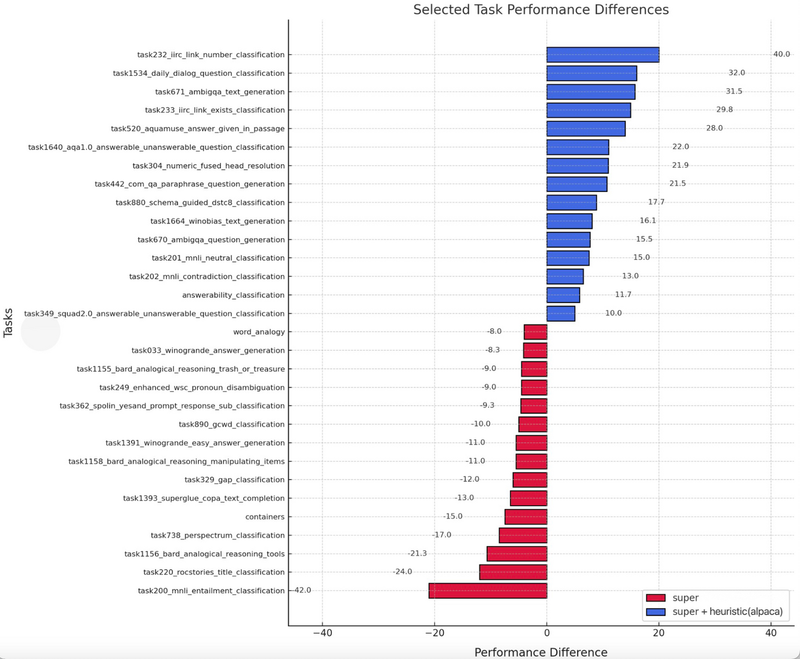


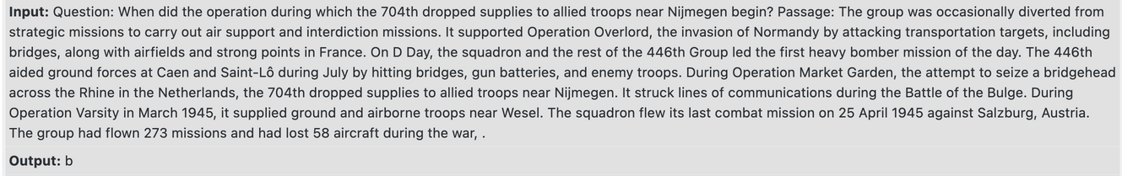

Analysis - Task Type
Task 232
Definition: In this task, you're given a question, along with a context passage which has extra information available on certain terms mentioned in it, i.e., the proper nouns in the passage. Your job is to determine whether information from more than one term is needed to answer the question. Indicate your choice as `a` for Yes or `b` for No.
Task 200
Definition: In this task, you're given a statement and three sentences as choices. Your job is to determine which sentence can be inferred from the statement. Incorrect choices change the meaning in important ways or have details that are not mentioned in the statement. Indicate your answer as 1,2, or 3 corresponding to the choice number of the selected sentence.
Improved performance: Task involving understanding long context.
Weakened performance: Textual entailment tasks.
Notes:
Slide 8
To gain more insight(s), we compared the performance with baseline model based task type.
The top rows are tasks where the integrated model improved and the bottom rows show tasks where performance worsened.
Overall, we observed improvement in tasks involving understanding long context like task 232.
However, we also noted a weakened performance in textual entailment tasks like task 200, possibly due to the hallucination issues in the synthetic dataset.

Slide 9

Analysis - Traits and Case Study
Instruction: Given an ambiguous question, provide one question which clarifies the input question. Input: With what are the german die br\u00fccke artists associated? Target: With what group are the german die br\u00fccke artists associated? | Instruction: Given an ambiguous question, provide one question which clarifies the input question. Input: With what are the german die br\u00fccke artists associated? Target: With what group are the german die br\u00fccke artists associated?
Model | Predictions
Super | Die Br\u00fccke is a German rock band.
Super+Alpaca | What are the German die br\u00fccke artists associated with?
Model | Average Character Length of Target of Better Tasks
SUPER + Alpaca | 95.4
SUPER | 33.3
Traits: Comparatively long-winded
Case: Higher score on EM / ROGUE-L on open-ended questions (because of long-winded?)
Notes:
Slide 9
In addition to performance analysis, we studied the character of our robot and found that our robot tends to be long-winded, providing longer output in tasks where it had performed better.
For instance, in open-end questions that required refining input, our model excelled with this characteristic. This suggests being long-winded may not always be a disadvantage.

Slide 10



Discussion & Conclusion
Evaluation Metric
Noise / Hallucination
Machine / Synthetic Data
EM & ROGUE-L may not be perfect to evaluate complex task performance
Synthetic data may prone to noise & hallucination
Uncertain what exactly synthetic dataset can bring to human-data only dataset.
Notes:
Slide 10
In final remark, there are limitations on our work.
Firstly, the SUPER benchmark using metric like EM may not be perfect to measure performance of complex task.
Secondly, our model is also prone to hallucination issue.
Additionally, the exact cause by which synthetic dataset improve NLP model might requires further deliberation.

Slide 11

Notes:
Slide 11
In any cases, it is very promising to know, we as students who just learnt NLP for 10 weeks, can contribute to the existing NLP community.
Let me cite a familiar quote from assignment 1 to end this presentation. Thank you very much.

Slide 12







Contribution
 | Literature Review + Proposal | Reproduce Model & Data Ablation Models | Analysis | Presentation | Writer (Proposal + Final)
Randal Chan
Liang Shihao
Du Yutong
Yan Chenjia
Li Jiajun
Key Member
Key Member
Key Member
Key Member
Key Member
Key Member
Key Member
Key Member
Key Member
Key Member
Key Member

